Slide 1

Data Mining Final
Tan Zhong ming

Slide 2
Problem
Human perspective bias on classifies an object
Low accuracy on manual prediction
Time consuming to identify possible solution and decision to support business

Slide 3
Machine Learning
Supervised
Unsupervised
Have label
Predict a given data tuple
ANN,SVM, Decision Tree, BBN
No label
Clustering or grouping data
K-Mean Clustering, Gaussian Mixture Models, Hidden Markov Model, Random Forest

Slide 4
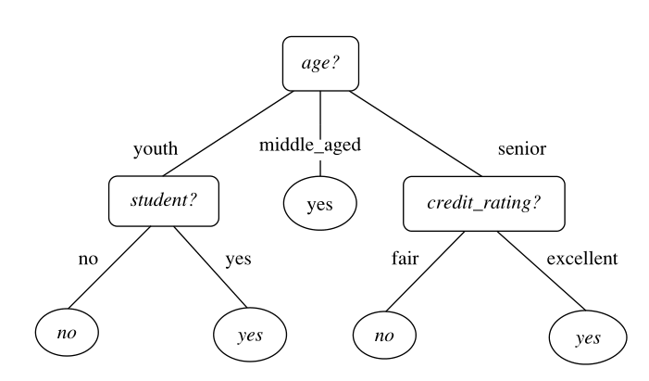
Tree
Leaf = label
Rectangle = attribute test (decision node)
Support multidimensional data
Only applicable for categorical label
Can be or not can be binary tree

Slide 5








Attribute Measure Selection
ID3 – information gain
C4.5 – gain ratio
CART – gini index

Slide 6


Naïve Bayesian
The P(X) is the prior probability of X
P(H|X) is the posterior probability of X conditioned on H.
P(H) is independent of X.
P(X|C_{i}) P(C_{i}) need to be maximized, since the P(X) is constant for all classes
The condition above shows the tuple X belong to the class if and only if the class have the highest posterior probability.

Slide 7
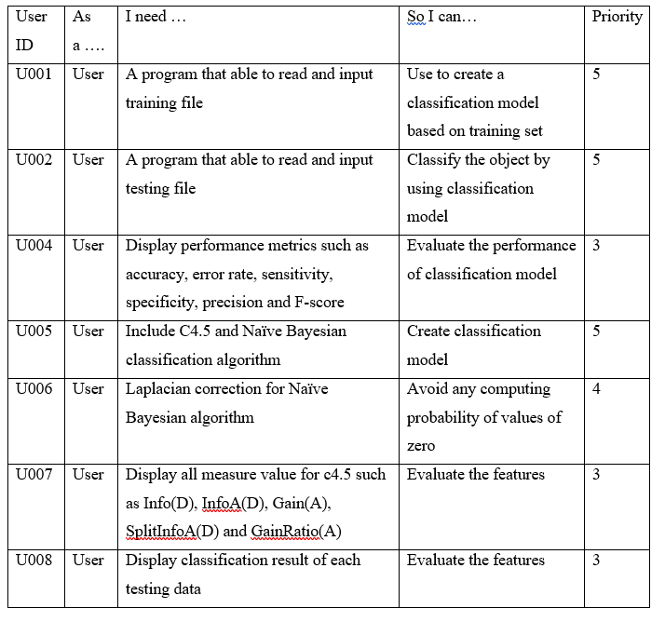
User story

Slide 8
Conclusion
learn decision tree induction, naïve Bayesian algorithm.
learn advanced classification method such as artificial neural network, support vector machine and so on.
We also developed C4.5 and naive Bayesian algorithm in this project by using python and compiled to executable file.

Slide 9
Conslusion
Strengths
Weakness
The strengths of this software using python library such as pandas and numpy which able to process large dataset without considering the memory or array size requirement.
The python provides a more easy and flexible maintenance environment without strictly define the data type.
It is able to store the csv for next iteration.
It is running in console application; it has the flexibility call by another program after few modifications.
Unable to store the classification model and decision tree.
Cannot export the resulting tree to picture such as jpeg.
Large software size, compiled software required 28MB storage. It can reduce by implementing another programming language or modify the setting for compilation.
Slow training process. The training process performance can increase by implementing parrilla processing.

